Slide 1
Entity/Relationship Modelling

Slide 2
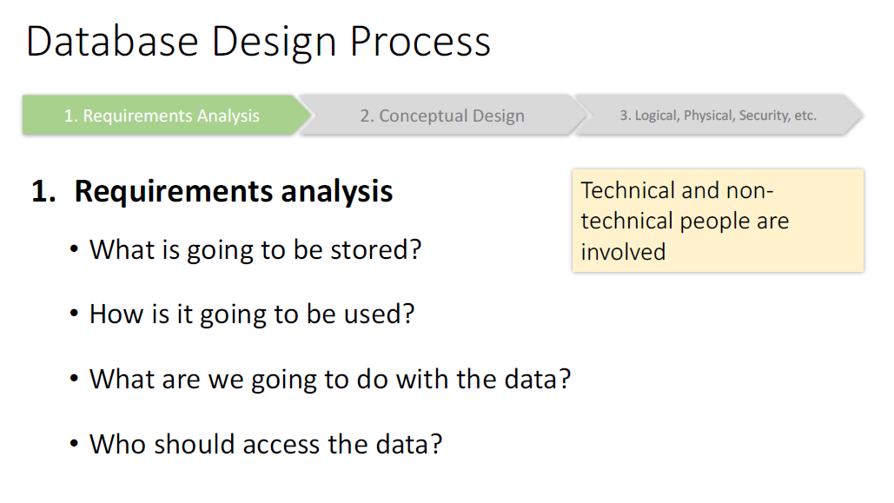

Slide 3
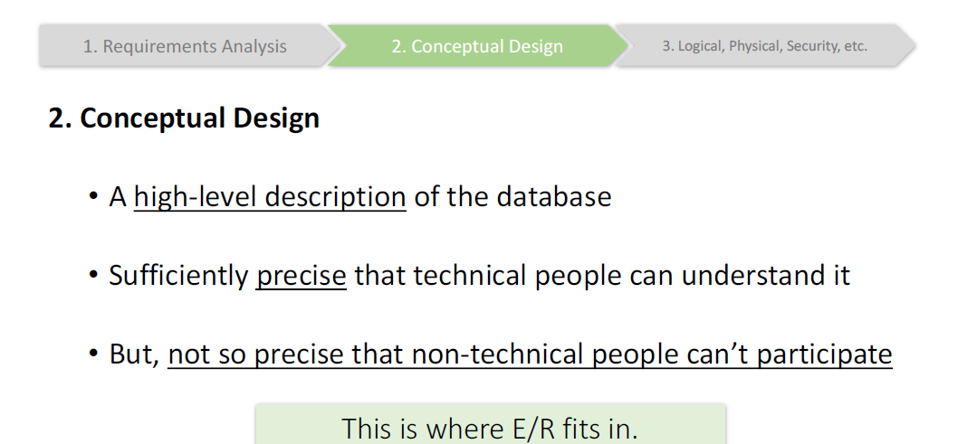

Slide 4
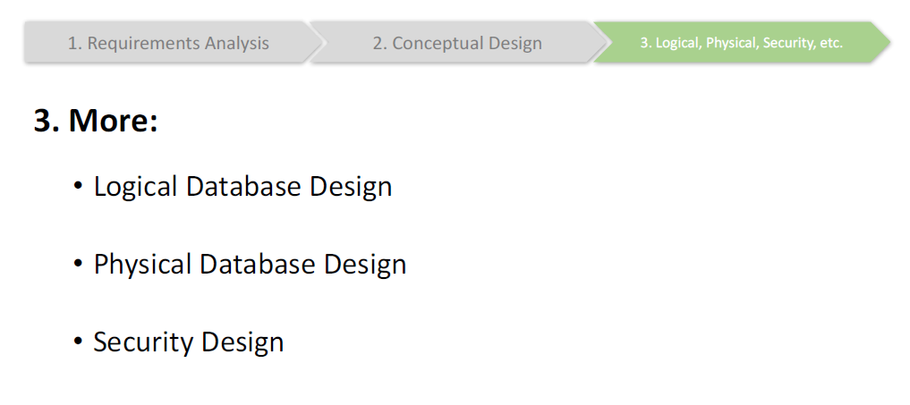

Slide 5
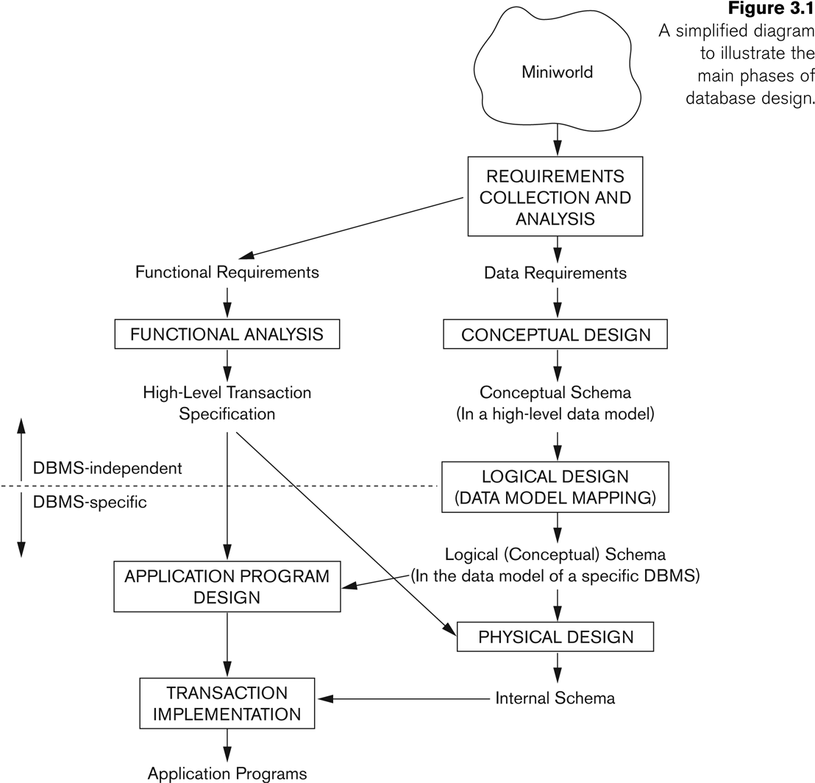

Slide 6
Database Design
Conceptual Design (cont’d)
The Entity-Relationship (ER) Model, UML
High-level, close to human thinking
Semantic model, intuitive, rich constructs
Not directly implementable
Logical Design (data model mapping)
The relational data model
Logical design translates ER into relational model (SQL)
Map conceptual schema to an implementation data model (e.g., relational database model)
Physical Design
Specify internal storage structures, indices, access paths and file organizations

Slide 7
Components of ERD
1. Entity.
A data entity is anything real or abstract about which we want to store data.
Entity types fall into five classes: roles, events, locations, tangible things or concepts.
E.g. employee, payment, campus, book.
2. Relationship.
A data relationship is a natural association that exists between one or more entities.
E.g. Employees process payments.
3. Cardinality.
Defines the number of occurrences of one entity for a single occurrence of the
related entity.
E.g. an employee may process many payments but might not process any payments depending on the nature of her job.
4. Attribute.
A data attribute is a characteristic common to all or most instances of a particular entity.
Synonyms include property, data element, field.
E.g. Name, address, Employee Number, pay rate are all attributes of the entity employee.

Slide 8
Entity
An entity, which is a thing or object in the real world with an independent existence.
An entity may be an object with a physical existence (for example, a particular person, car, house, or employee) or it may be an object with a conceptual existence (for instance, a company, a job, or a university course).
Each entity has attributes—the particular properties that describe it.

Slide 9
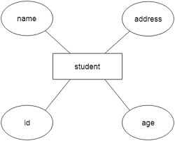
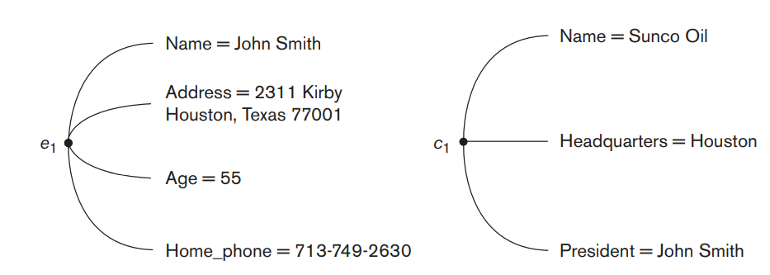

Slide 10
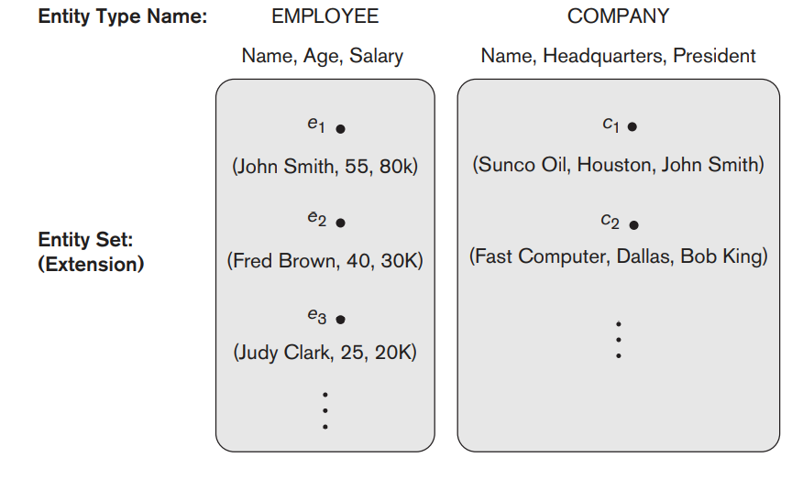
Entity type
An entity type defines a collection (or set) of entities that have the same attributes.
Each entity type in the database is described by its name and attributes.
Two entity types: EMPLOYEE and COMPANY, and a list of some of the attributes for each

Slide 11
Entity Set
The collection of all entities of a particular entity type in the database at any point in time is called an entity set or entity collection
The entity set is usually referred to using the same name as the entity type, even though they are two separate concepts.
For example, EMPLOYEE refers to both a type of entity as well as the current collection of all employee entities in the database.

Slide 12
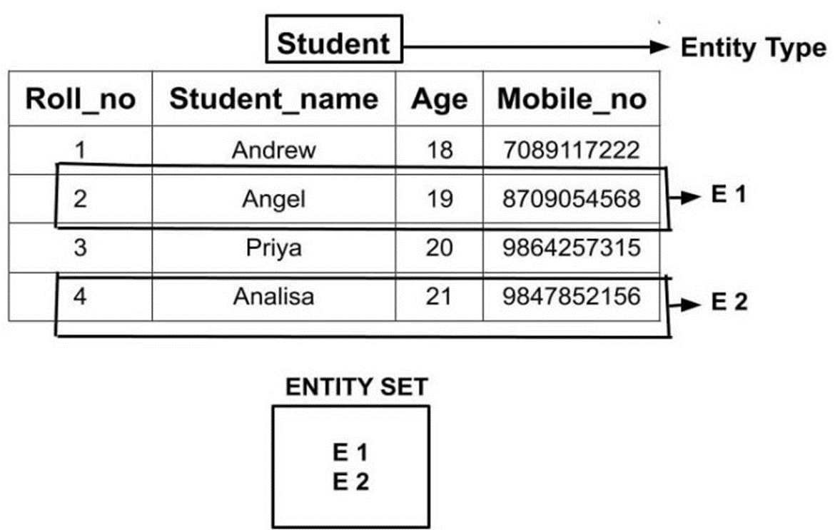

Slide 13
Attributes
An entity is represented by a set of attributes, that is descriptive properties possessed by all members of an entity set.
Example:
instructor = (ID, name, street, city, salary ) course= (course_id, title, credits)
Attribute types:
Simple and composite attributes.
Key Attribute
Single-valued and multivalued attributes
Example: multivalued attribute: phone_numbers
Derived attributes
Can be computed from other attributes
Example: age, given date_of_birth

Slide 14
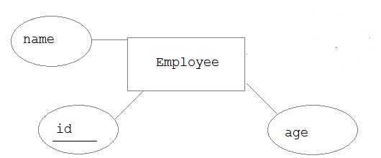
Key Attribute
The attribute which uniquely identifies each entity in the entity set is called key attribute.
For example, Roll_No will be unique for each student.

Slide 15
Simple and Composite Attributes
Composite attributes can be divided into smaller subparts, which represent more basic attributes with independent meanings.
Attributes that are not divisible are called simple or atomic attributes.
Composite attributes can form a hierarchy;
For example, Street_address can be further subdivided into three simple component attributes: Number, Street, and Apartment_number,

Slide 16
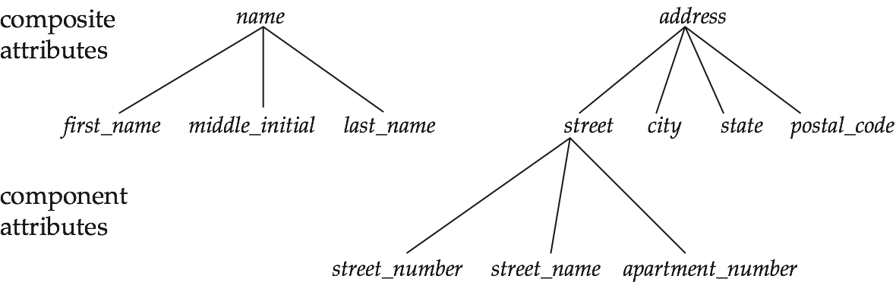

Slide 17
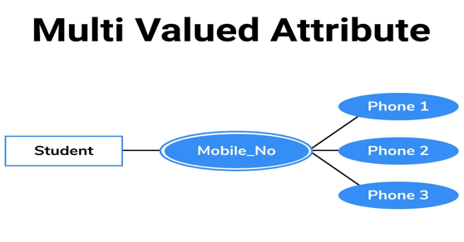
Single-valued and multivalued attributes
Most attributes have a single value for a particular entity; such attributes are called single-valued. For example, Age is a single-valued attribute of a person.
An attribute consisting more than one value for a given entity are called multi valued . For example, Phone_No (can be more than one for a given student).

Slide 18
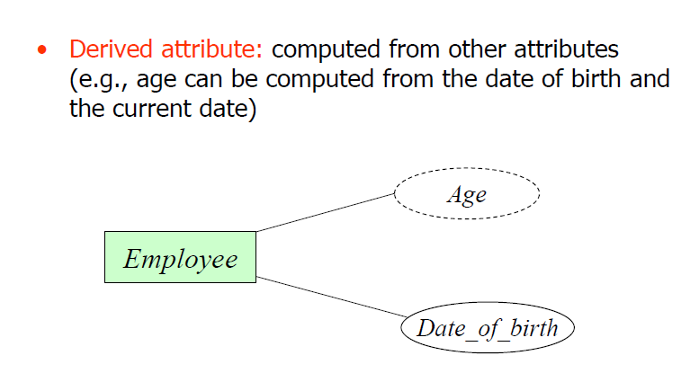

Slide 19
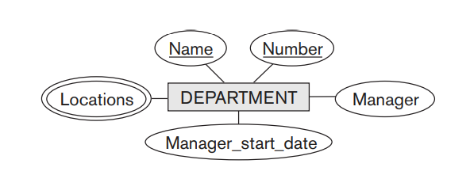

Slide 20
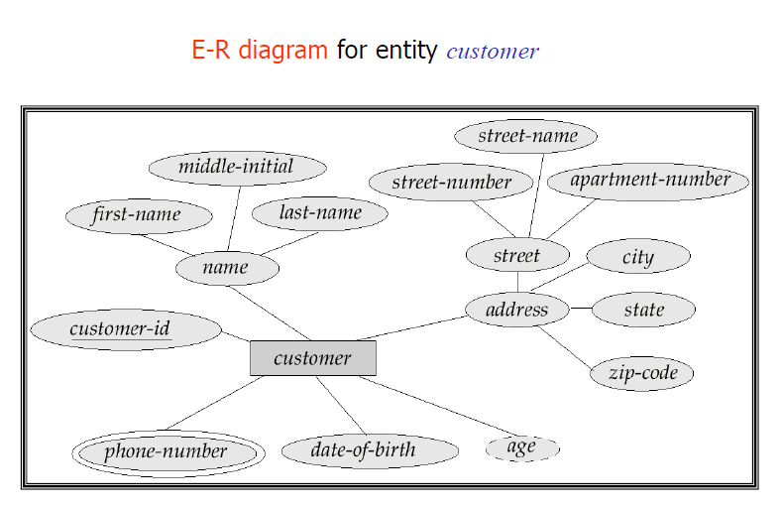

Slide 21
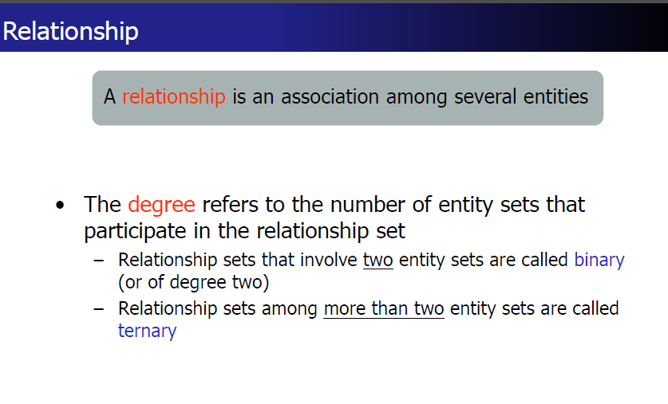

Slide 22
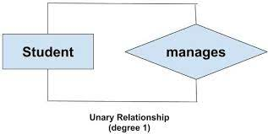
Degree of a relationship set: The number of different entity sets participating in a relationship set is called as degree of a relationship set.
1. Unary Relationship – When there is only ONE entity set participating in a relation, the relationship is called as unary relationship. For example, one person is married to only one person.

Slide 23
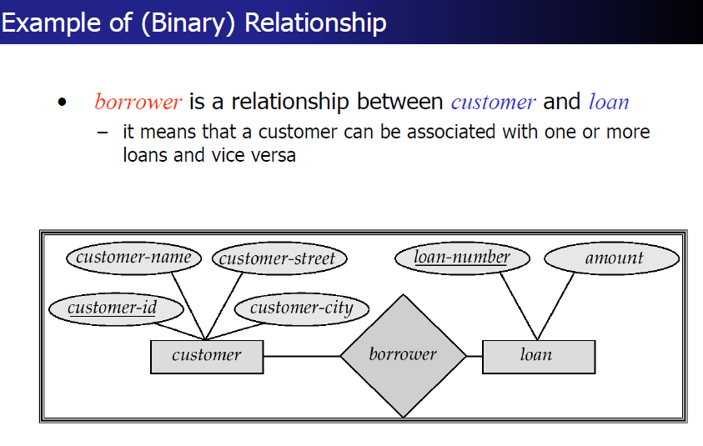

Slide 24
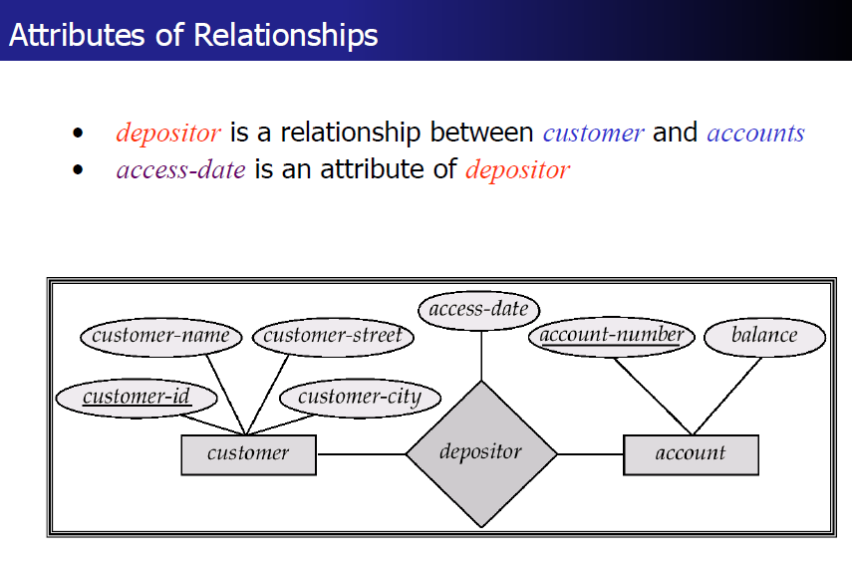

Slide 25
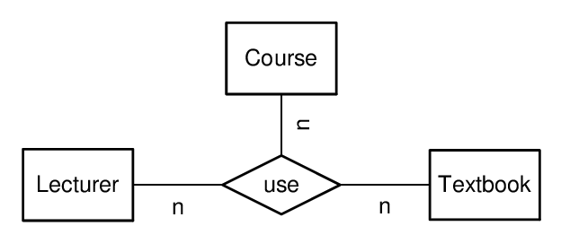
Ternary relationship type

Slide 26
Mapping Cardinality Constraints
Express the number of entities to which another entity can be associated via a relationship set.
Most useful in describing binary relationship sets.
For a binary relationship set the mapping cardinality must be one of the following types:
One to one
One to many
Many to one
Many to many

Slide 27
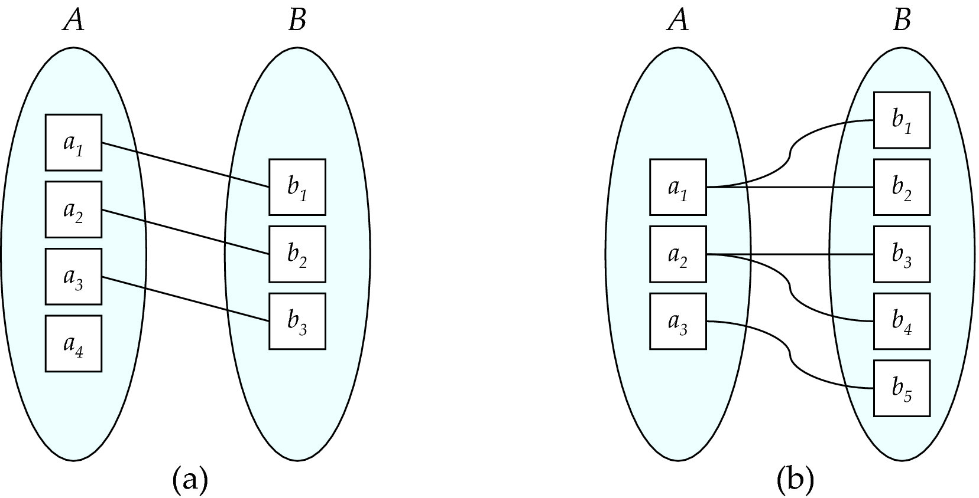
Mapping Cardinalities
One to one
One to many
Note: Some elements in A and B may not be mapped to any
elements in the other set

Slide 28
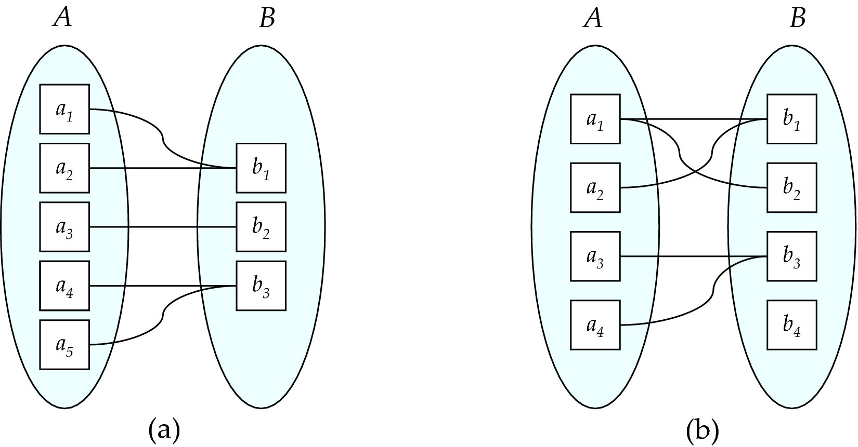
Mapping Cardinalities
Many to one
Many to many
Note: Some elements in A and B may not be mapped to any
elements in the other set

Slide 29
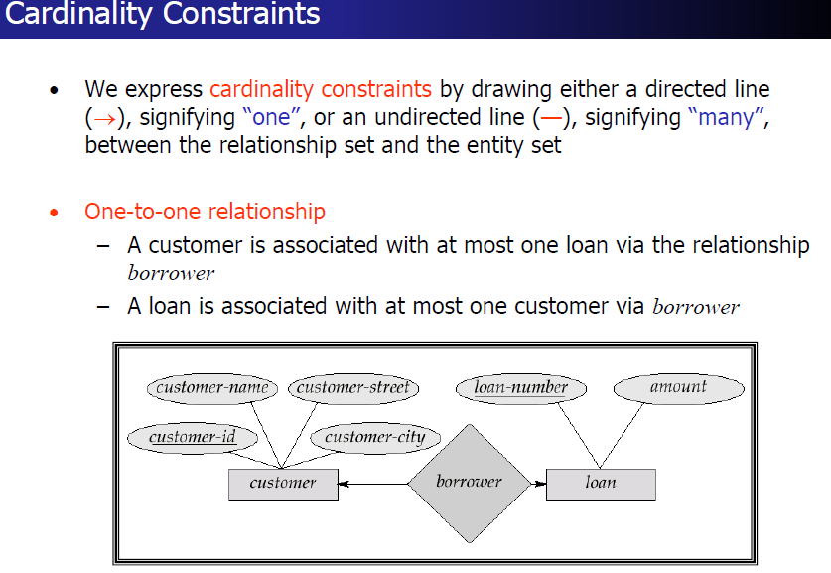

Slide 30
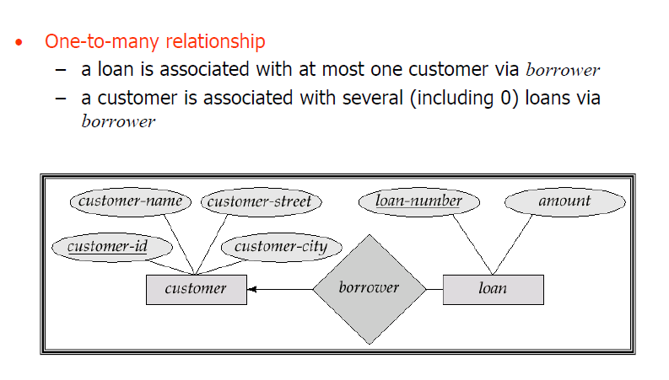

Slide 31
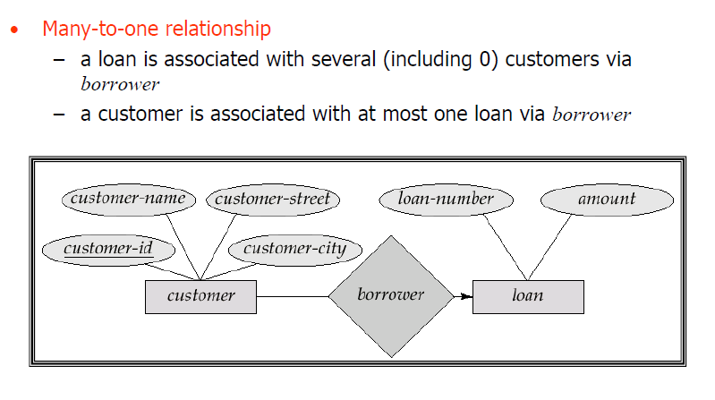

Slide 32
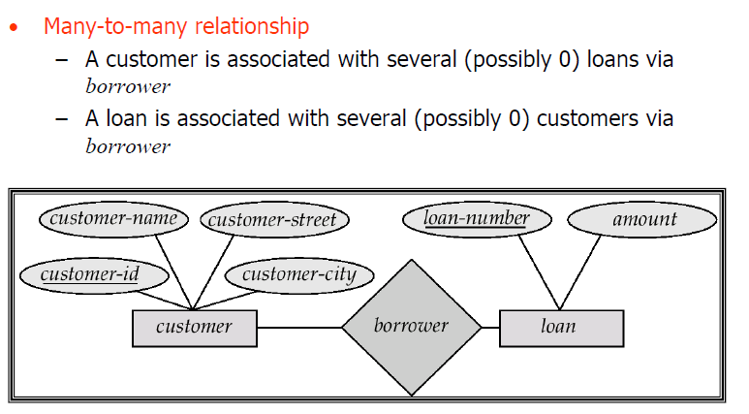

Slide 33
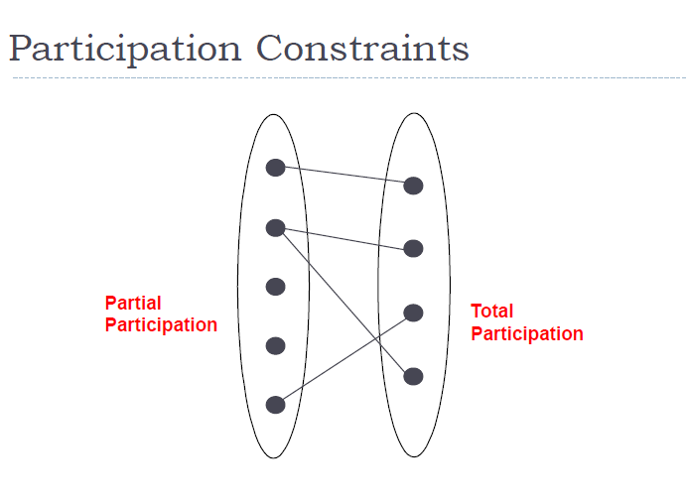

Slide 34
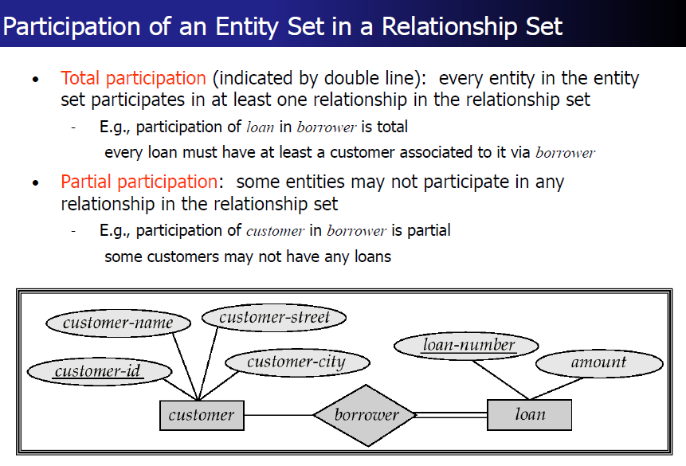

Slide 35
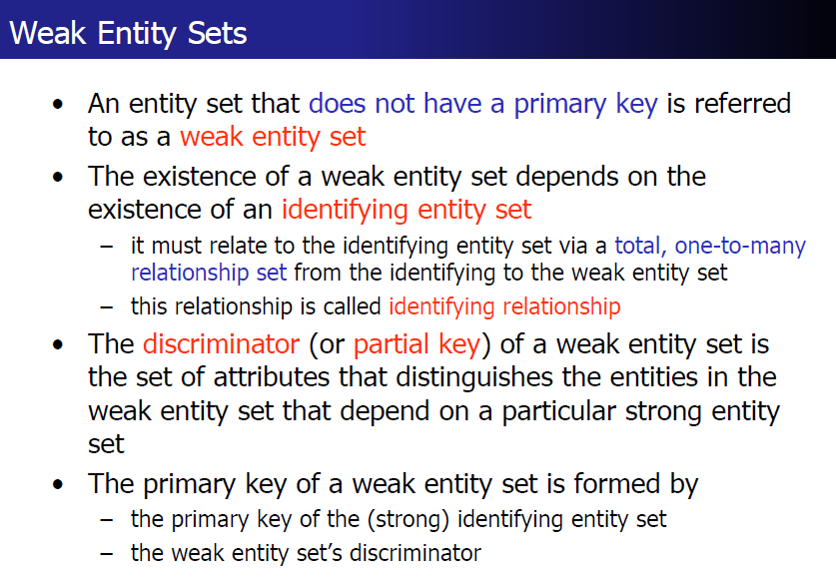

Slide 36
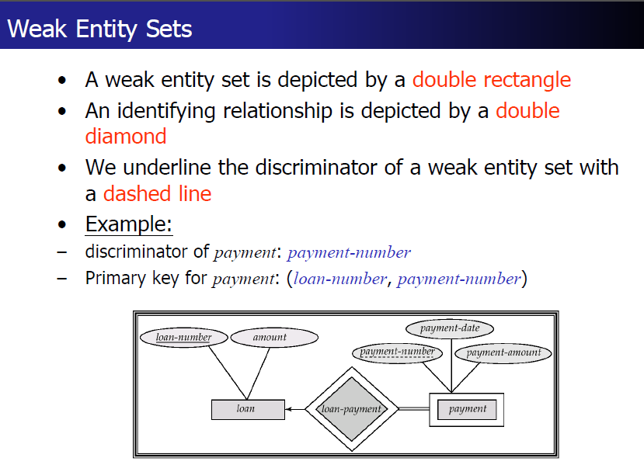

Slide 37
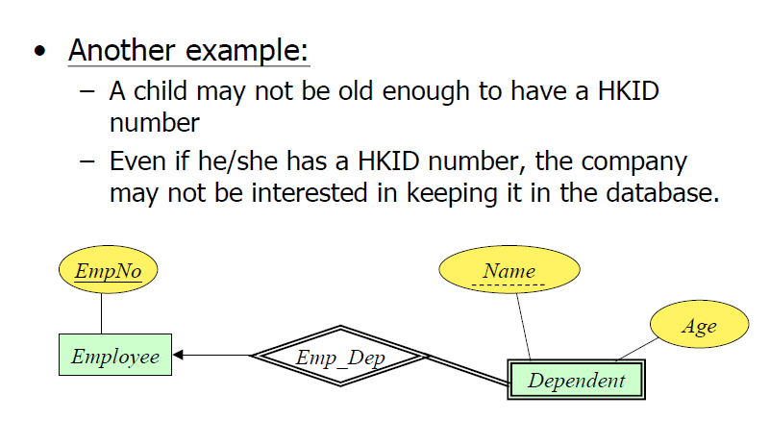

Slide 38
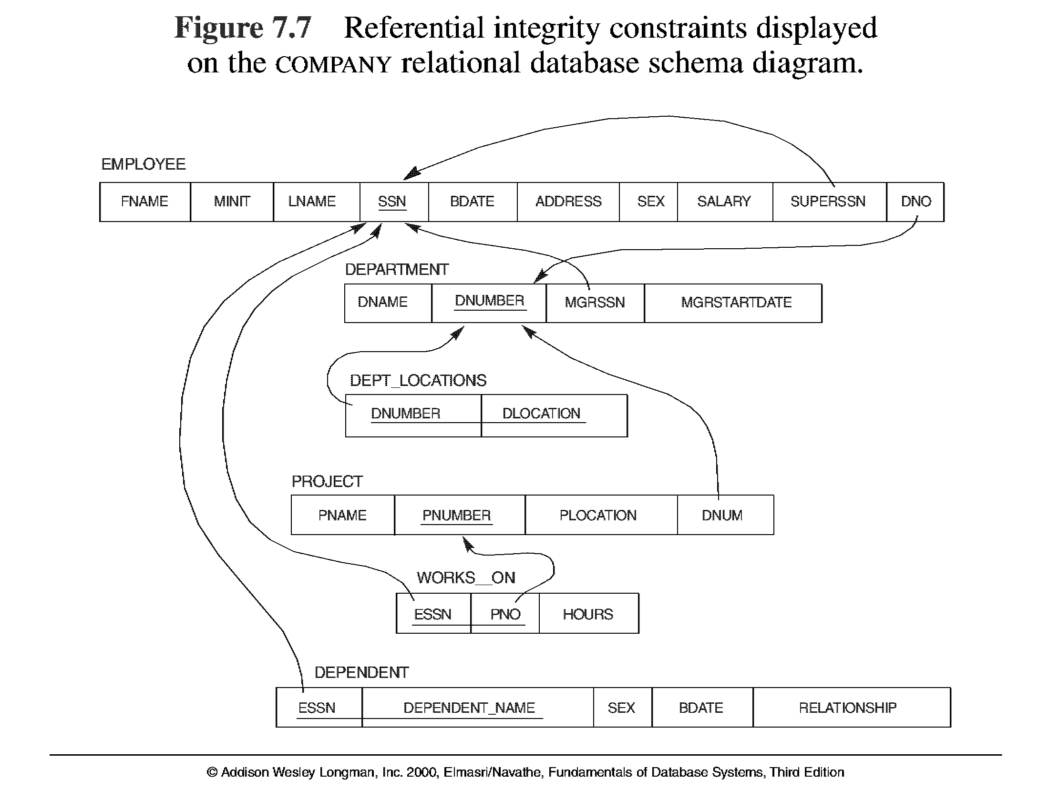

Slide 40
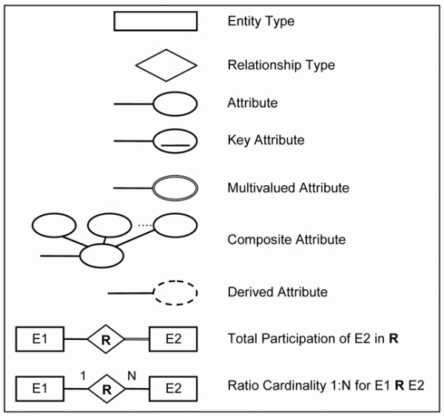

Slide 41
A banking scenario
• Banks have customers.
• Customers are identified by name, custid, phone number and address.
• Customers can have one or more accounts
• Accounts are identified by an account number, account type (savings, current) and a balance.
• Customers can avail loans.
• Loans are identified by loan id, loan type (car, home, personal)
• and an amount.
• Banks are identified by a name, code and the address of the main office.
• Banks have branches.
• Branches are identified by a branch number, branch name and an address.
• Accounts and loans are related to the banks’ branches.
• Create an ER diagram for a database to represent this application

Slide 42
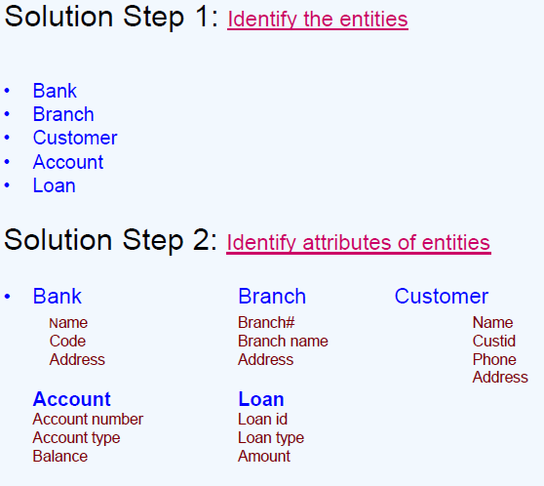

Slide 43
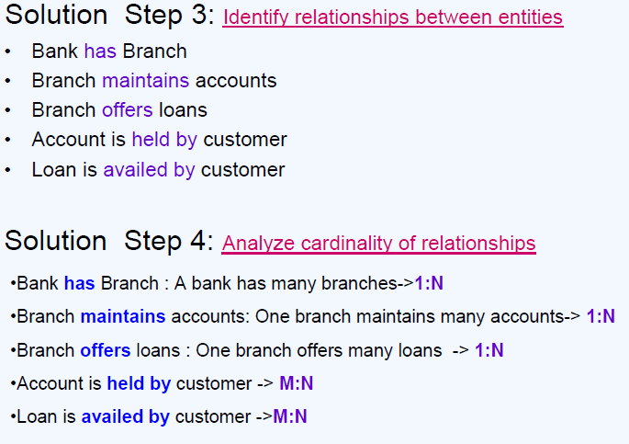

Slide 44
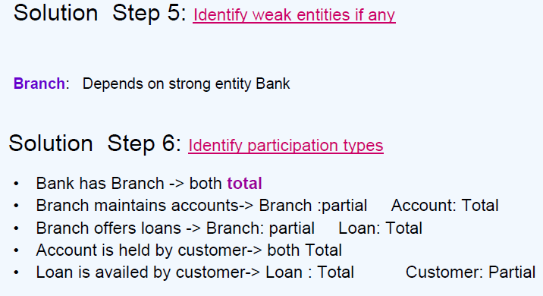

Slide 45
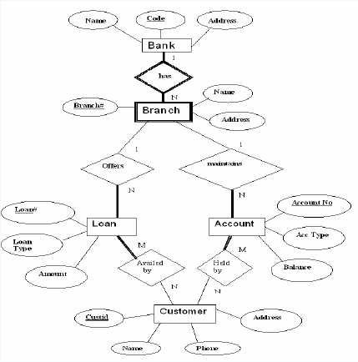

Slide 46
Example
A university consists of a number of departments. Each department offers several courses. A number of modules make up each course. Students enrol in a particular course and take modules towards the completion of that course. Each module is taught by a lecturer from the appropriate department, and each lecturer tutors a group of students

Slide 47
Example - Entities
A university consists of a number of departments. Each department offers several courses. A number of modules make up each course. Students enrol in a particular course and take modules towards the completion of that course. Each module is taught by a lecturer from the appropriate department, and each lecturer tutors a group of students

Slide 48
Example - Relationships
A university consists of a number of departments. Each department offers several courses. A number of modules make up each course. Students enrol in a particular course and take modules towards the completion of that course. Each module is taught by a lecturer from the appropriate department, and each lecturer tutors a group of students

Slide 49
Example - E/R Diagram
Entities: Department, Course, Module, Lecturer, Student
Department
Course
Module
Lecturer
Student

Slide 50
Example - E/R Diagram
Each department offers several courses
Offers
Department
Course
Module
Lecturer
Student

Slide 51
Example - E/R Diagram
A number of modules make up each courses
Offers
Department
Course
Includes
Module
Lecturer
Student

Slide 52
Example - E/R Diagram
Students enrol in a particular course
Offers
Department
Course
Includes
Module
Lecturer
Enrols In
Student

Slide 53
Example - E/R Diagram
Students … take modules
Offers
Department
Course
Includes
Module
Lecturer
Takes
Enrols In
Student

Slide 54
Example - E/R Diagram
Each module is taught by a lecturer
Offers
Department
Course
Includes
Module
Teaches
Lecturer
Takes
Enrols In
Student

Slide 55
Example - E/R Diagram
a lecturer from the appropriate department
Offers
Department
Employs
Course
Includes
Module
Teaches
Lecturer
Takes
Enrols In
Student

Slide 56
Example - E/R Diagram
each lecturer tutors a group of students
Offers
Department
Employs
Course
Includes
Module
Teaches
Lecturer
Takes
Enrols In
Student
Tutors

Slide 57
Example - E/R Diagram
Offers
Department
Employs
Course
Includes
Module
Teaches
Lecturer
Takes
Enrols In
Student
Tutors

Slide 58
Example - 2
We want to represent information about products in a database. Each product has a description, a price and a supplier. Suppliers have addresses, phone numbers, and names. Each address is made up of a street address, a city, and a postcode.

Slide 59
Example - Entities/Attributes
Entities or attributes:
product
description
price
supplier
address
phone number
name
street address
city
postcode
Products, suppliers, and addresses all have smaller parts so we can make them entities
The others have no smaller parts and belong to a single entity

Slide 60
Example - E/R Diagram
Price
Description
Product
Street address
Name
Supplier
Address
City
Phone number
Postcode

Slide 61
Example - Relationships
Each product has a supplier
Each product has a single supplier but there is nothing to stop a supplier supplying many products
A many to one relationship
Each supplier has an address
A supplier has a single address
It does not seem sensible for two different suppliers to have the same address
A one to one relationship

Slide 62
Example - E/R Diagram
Price
Description
Product
Has A
Street address
Name
Supplier
Has A
Address
City
Phone number
Postcode

Slide 63
One to One Relationships
Some relationships between entities, A and B, might be redundant if
It is a 1:1 relationship between A and B
Every A is related to a B and every B is related to an A
Example - the supplier-address relationship
Is one to one
Every supplier has an address
We don’t need addresses that are not related to a supplier

Slide 64
Redundant Relationships
We can merge the two entities that take part in a redundant relationship together
They become a single entity
The new entity has all the attributes of the old one
a
x
b
A
B
y
c
z
a
x
b
AB
y
c
z

Slide 65
Example - E/R Diagram
Price
Description
Product
Has A
Name
Supplier
City
Phone number
Postcode
Street address

Slide 66
Example -3
Employees work in departments; each department is managed by an employee; a child must be identified uniquely by name when the parent (who is an employee; assume that only one parent works for the company) is known. We are not interested in information about a child once the parent leaves the company.
Draw an ER diagram that captures this information.

Slide 67
Solution
dname
salary
phone
dno
ssn
budget
Employees
Manages
Departments
Dependent
Dependent
Works_In
Child
Child
name
name
age

Slide 68
Example -4
A department employs many employees, but each employee is employed by one department.
A division operates many departments, but each department is operated by one division.
An employee may be assigned to many projects, and a project may have many employees assigned to it.
A project must have at least one employee assigned to it.
One of the employees manages each department, and each department is managed by only one employee.
One of the employees runs each division, and each division is run by one employee.

Slide 69
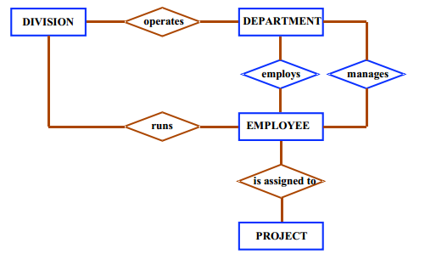

Slide 70
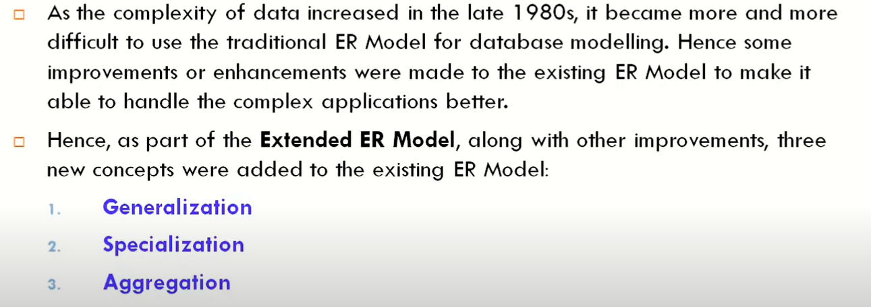
Enhanced ER

Slide 71
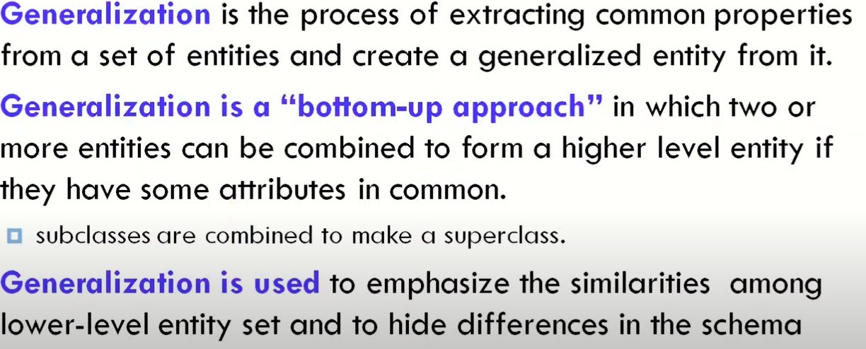
Generalization

Slide 72
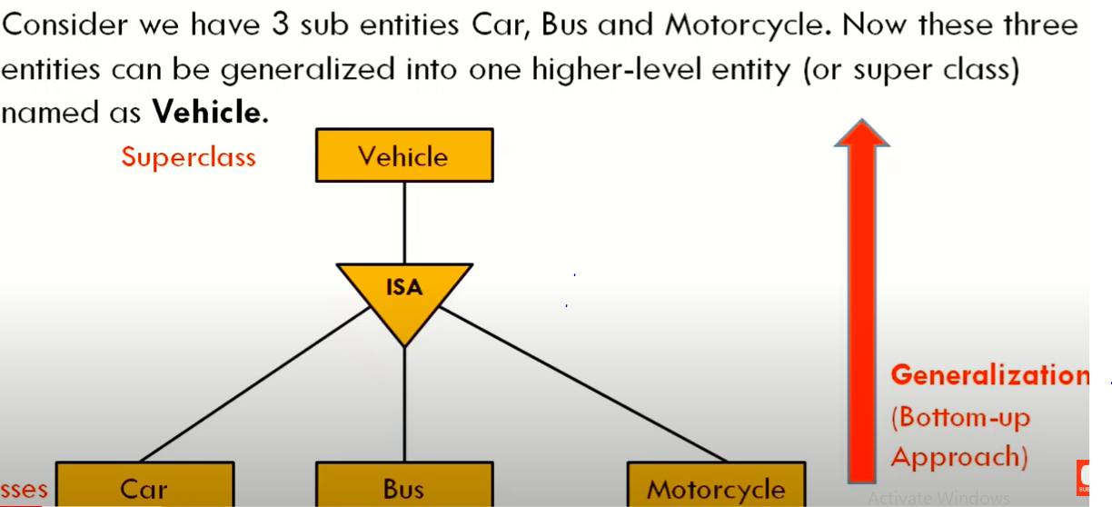

Slide 73
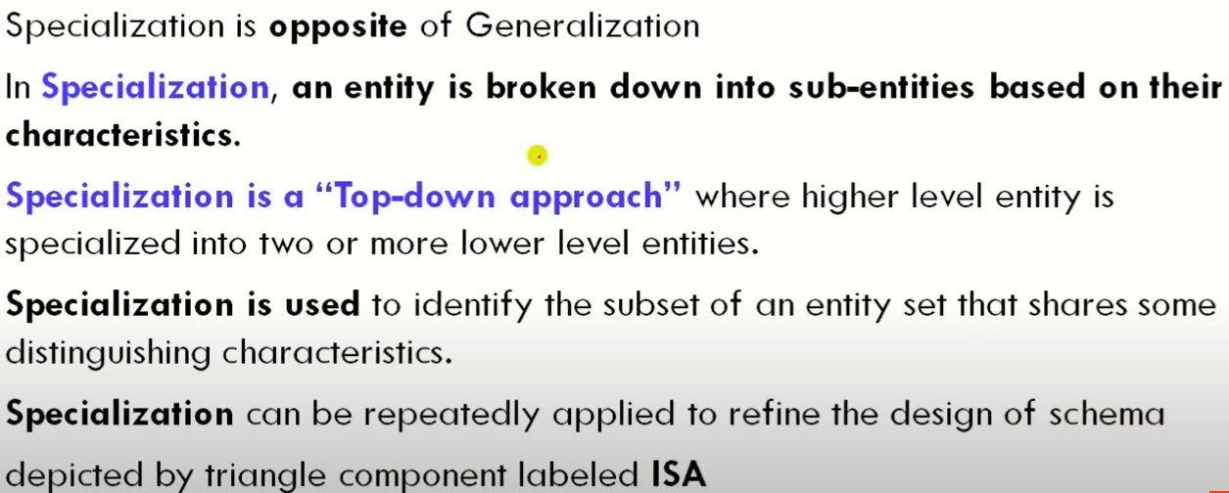
Specialization

Slide 74
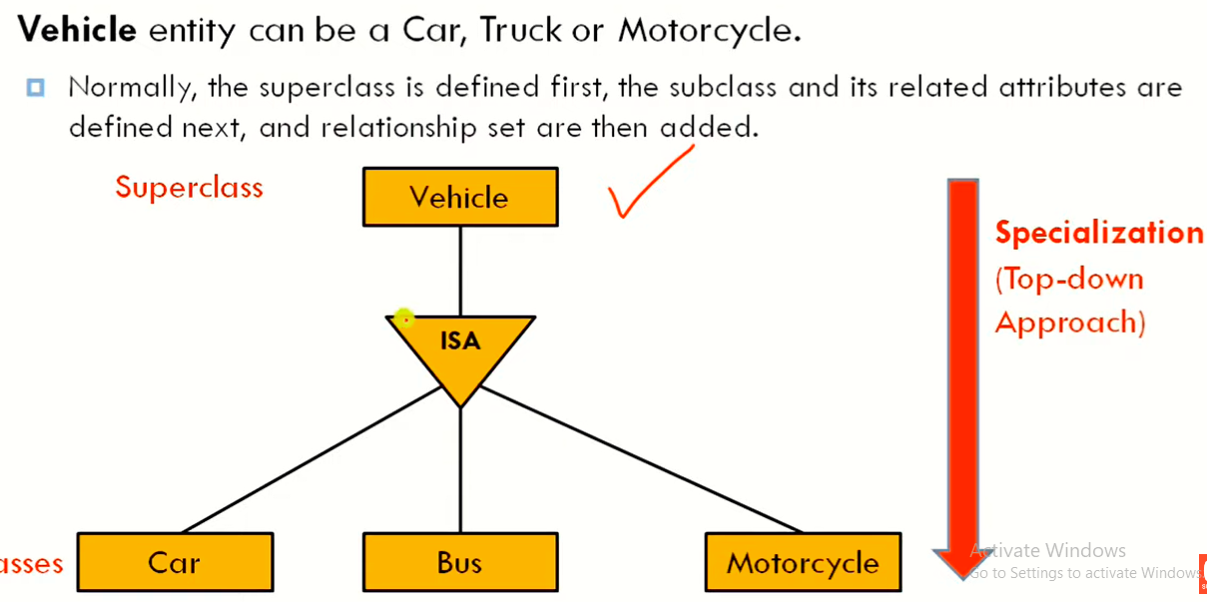

Slide 75
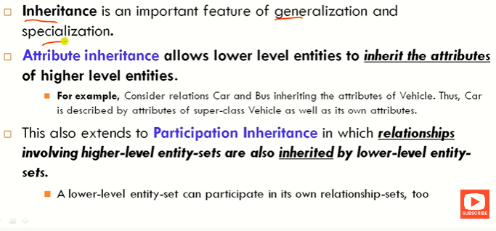
Inheritance

Slide 76
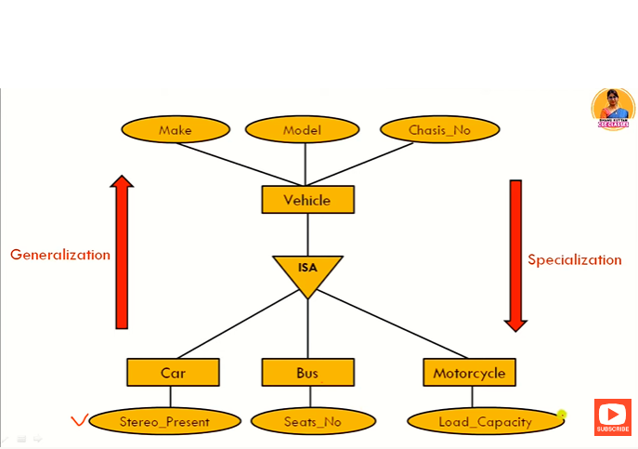

Slide 77
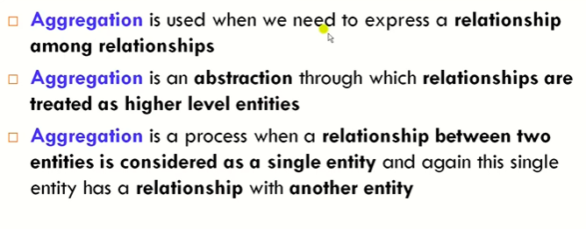
Aggregation

Slide 78
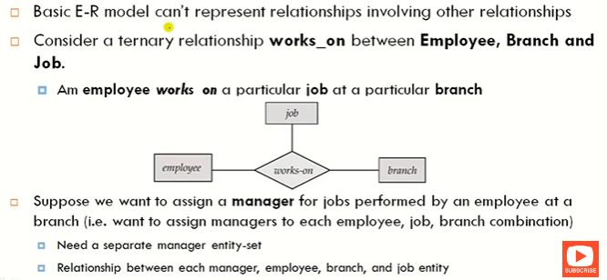

Slide 79
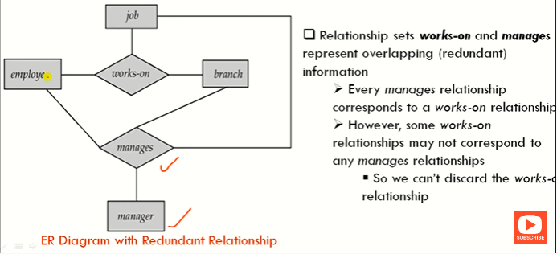

Slide 80
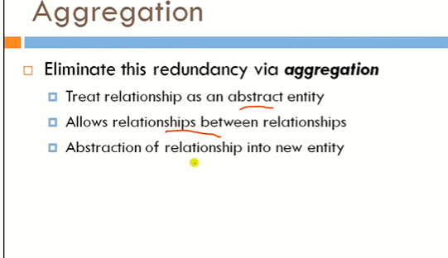

Slide 81
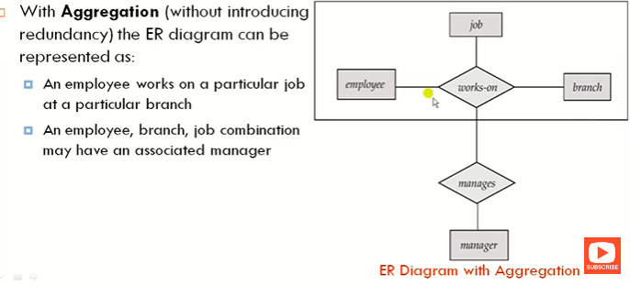

Slide 82
ER – Relational Schema

Slide 83
Separate Table
Strong Entity
Weak entity
M:N Relationships
Multi valued Attribute(MVA)
Composite Attributes

